Slide 1
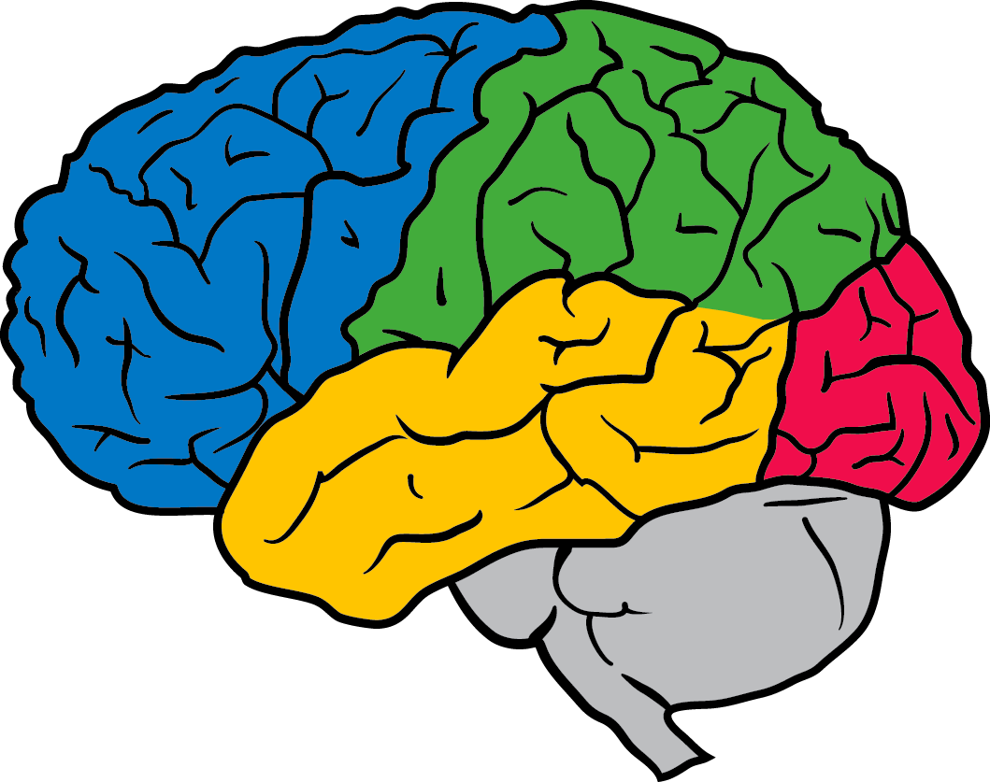

Tutorial on Optimization for Deep Networks
Ian Goodfellow
Senior Research Scientist
Google Brain
Re-Work Deep Learning Summit
San Francisco
Jan 28, 2016
Notes:
An alternative way to handle sequence data with neural networks

Slide 2
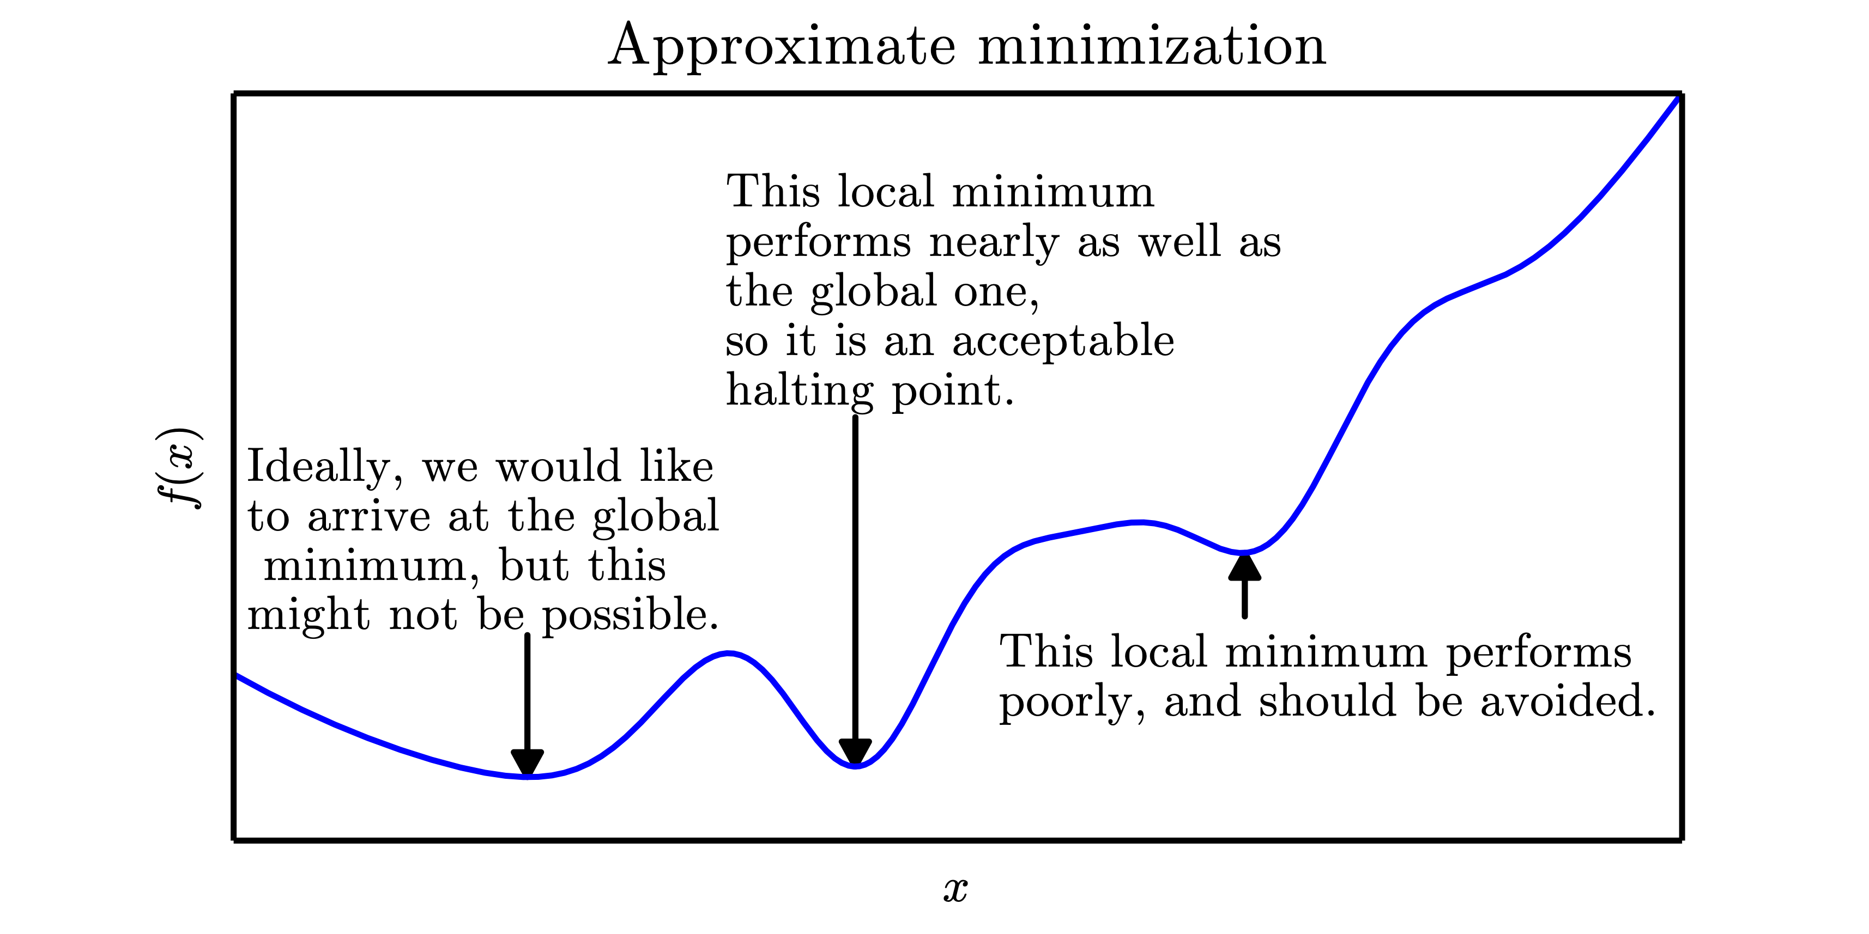
www.deeplearningbook.org
Deep Learning, Goodfellow, Bengio, and Courville 2016

Slide 3
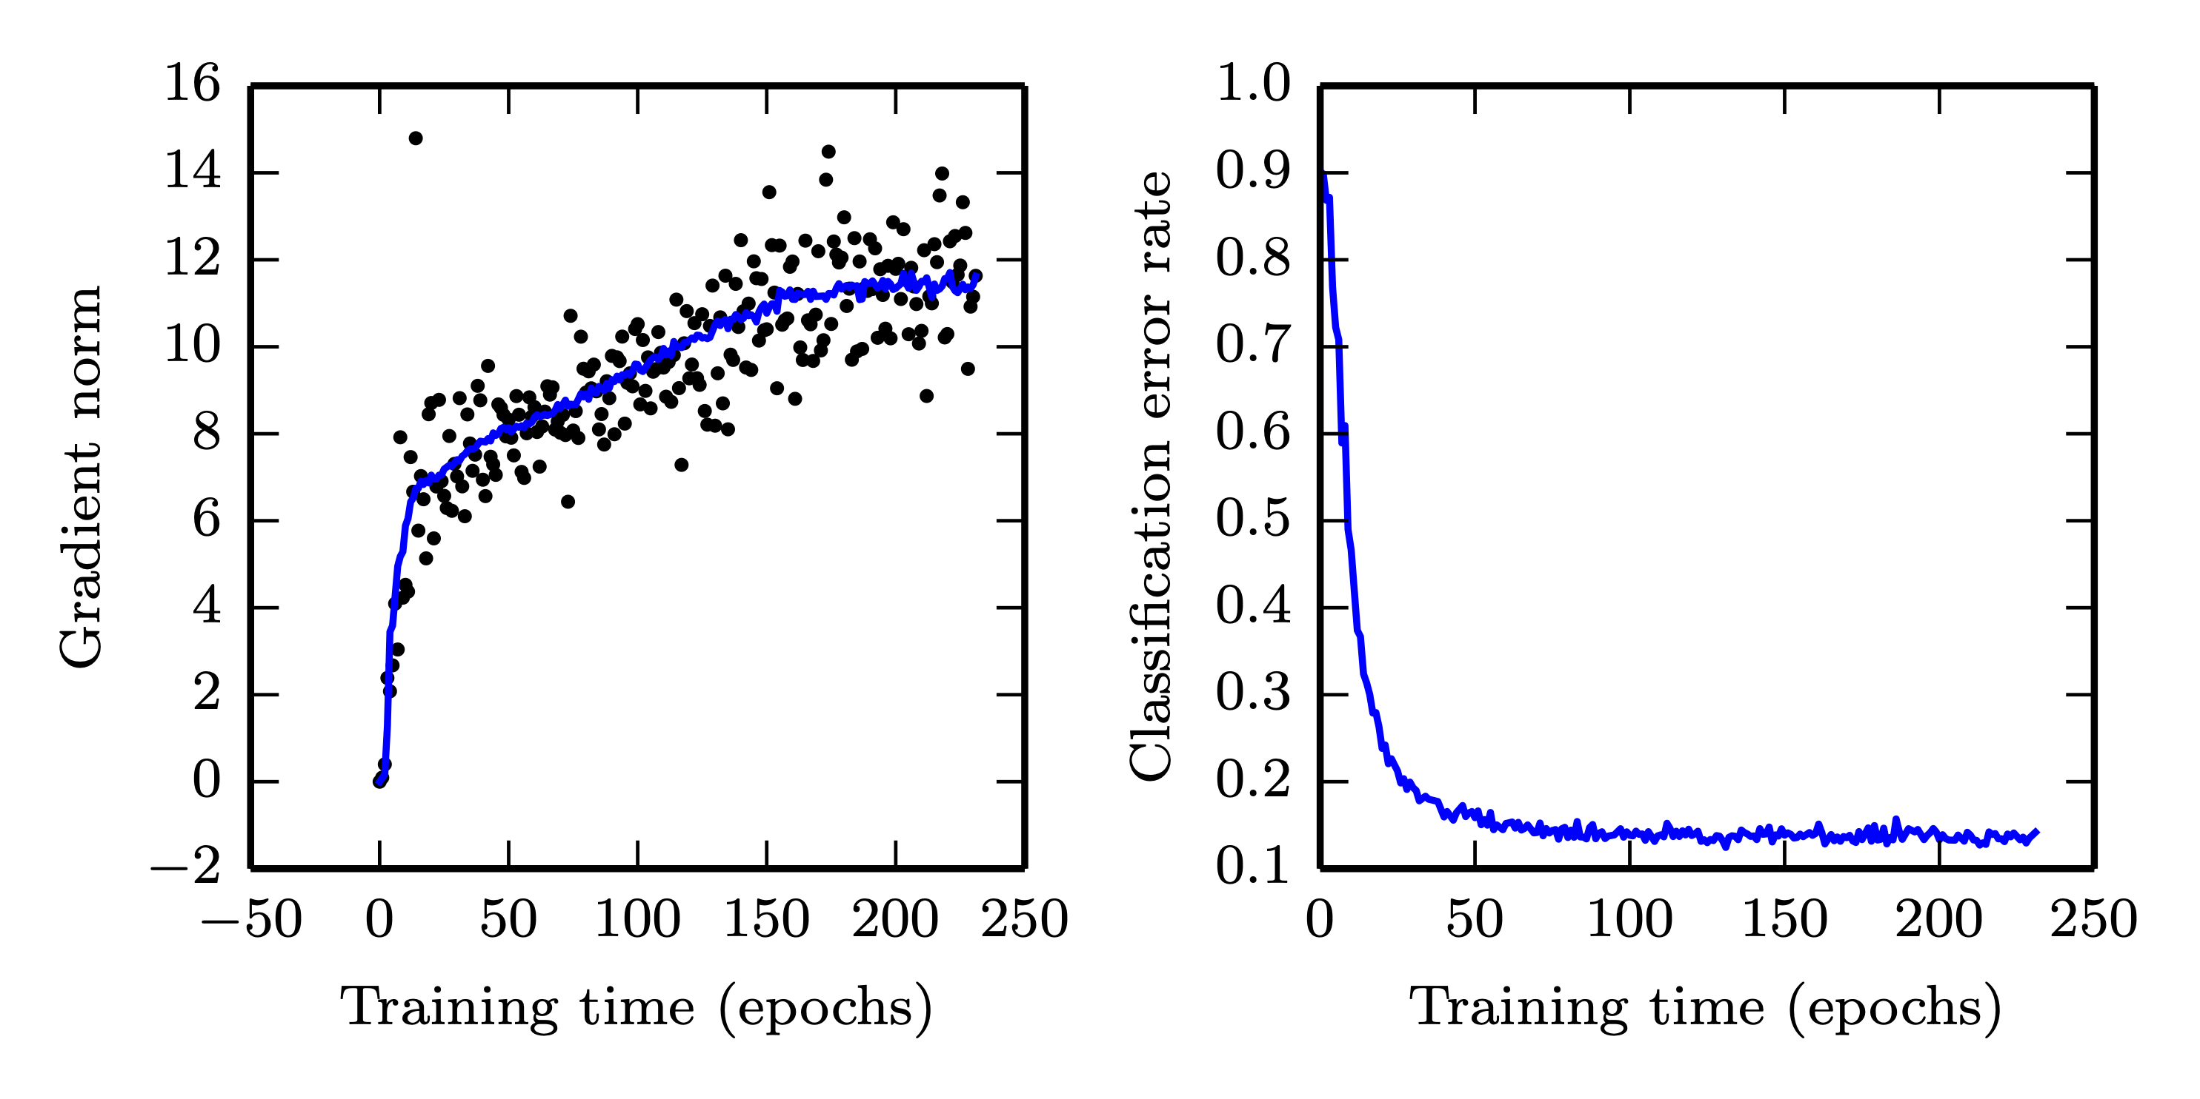
No Critical Point
www.deeplearningbook.org
Deep Learning, Goodfellow, Bengio, and Courville 2016

Slide 4
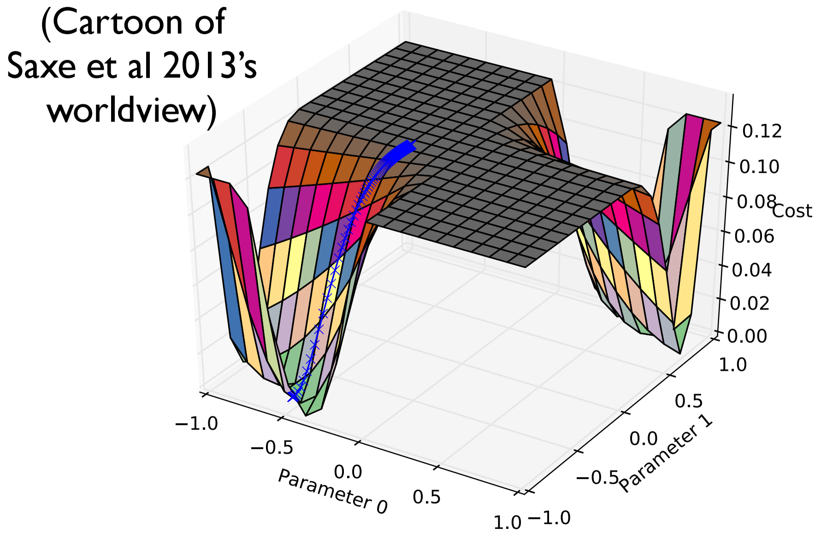

Slide 5
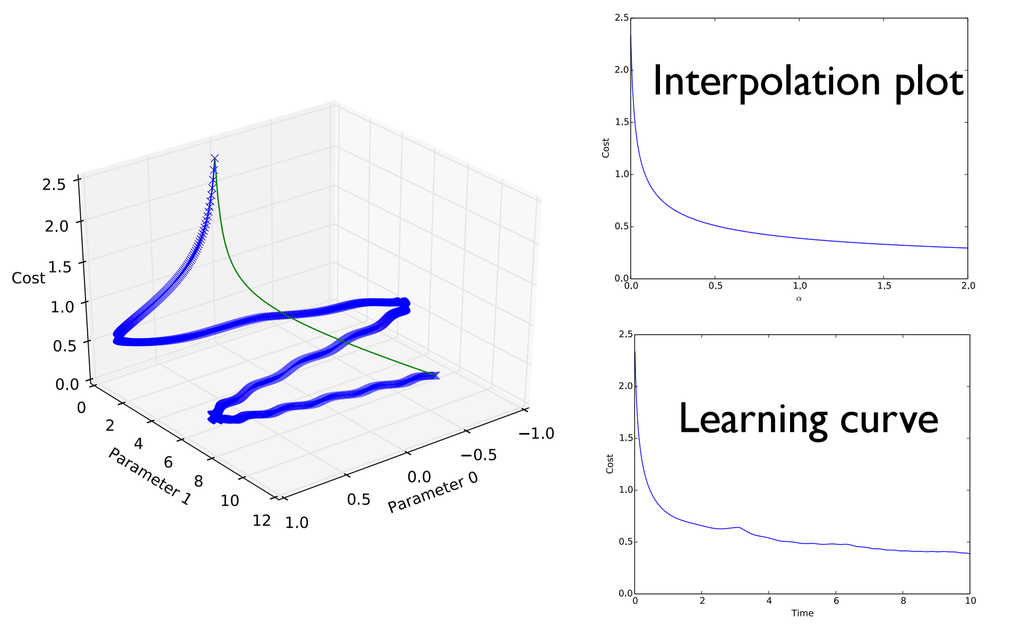
“Qualitatively Characterizing Neural Network
Optimization Problems,”
Goodfellow, Vinyals and Saxe, ICLR 2015

Slide 6
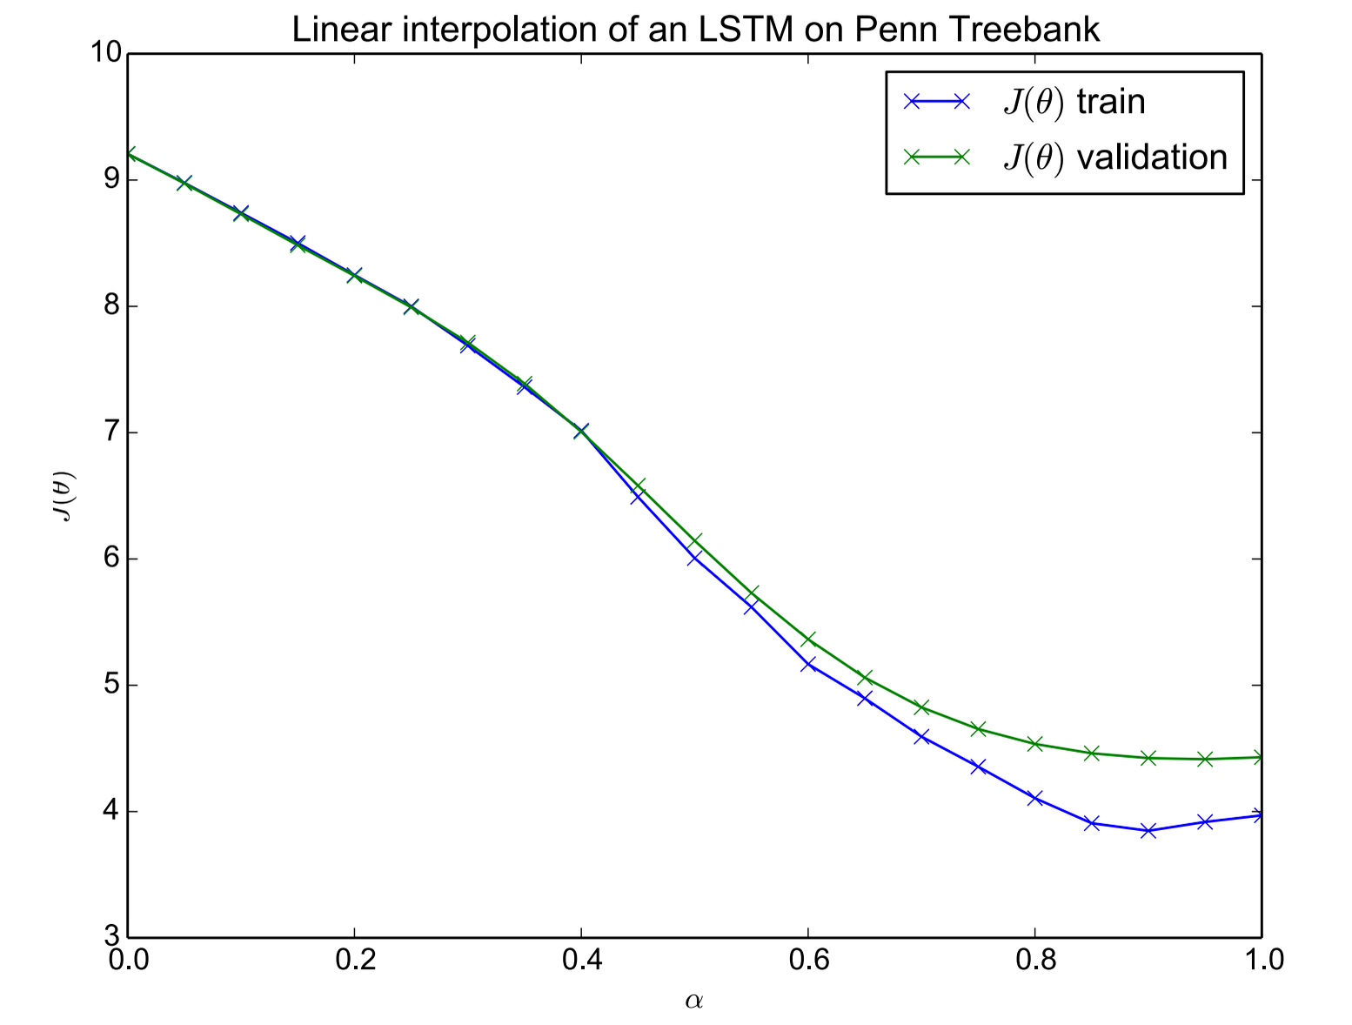
“Qualitatively Characterizing Neural Network
Optimization Problems,”
Goodfellow, Vinyals and Saxe, ICLR 2015

Slide 7
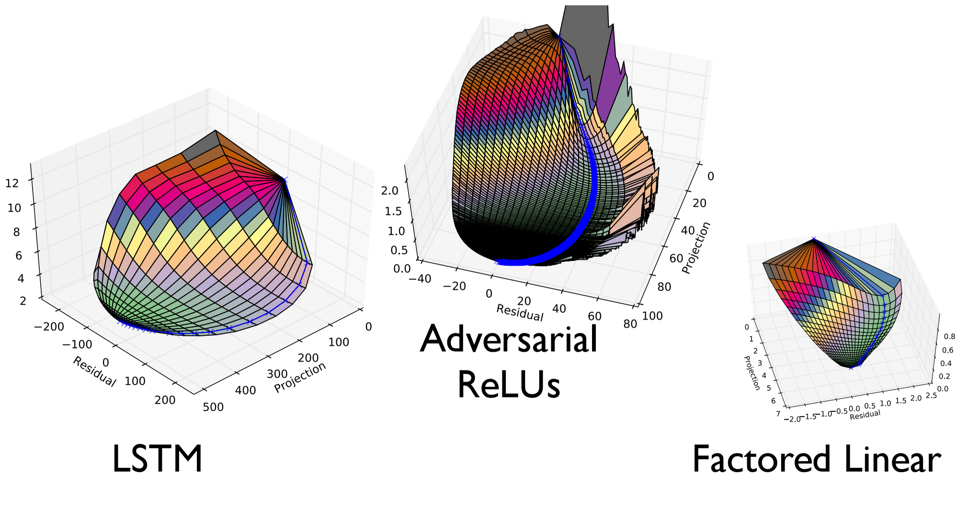
“Qualitatively Characterizing Neural Network
Optimization Problems,”
Goodfellow, Vinyals and Saxe, ICLR 2015

Slide 8
Before SGD step
After SGD step
“Batch Normalization: Accelerating Deep
Network Training by Reducing Internal
Covariate Shift,” Ioffe and Szegedy 2015

Slide 9
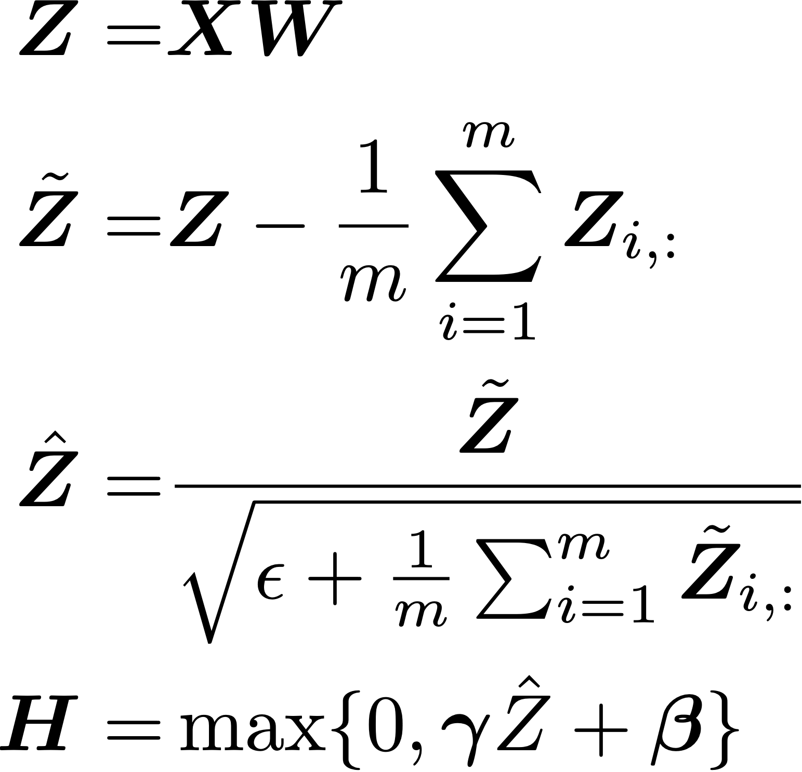
Batch Normalization
2
“Batch Normalization: Accelerating Deep
Network Training by Reducing Internal
Covariate Shift,” Ioffe and Szegedy 2015

Slide 10
Before SGD step
After SGD step
“Batch Normalization: Accelerating Deep
Network Training by Reducing Internal
Covariate Shift,” Ioffe and Szegedy 2015

Slide 11
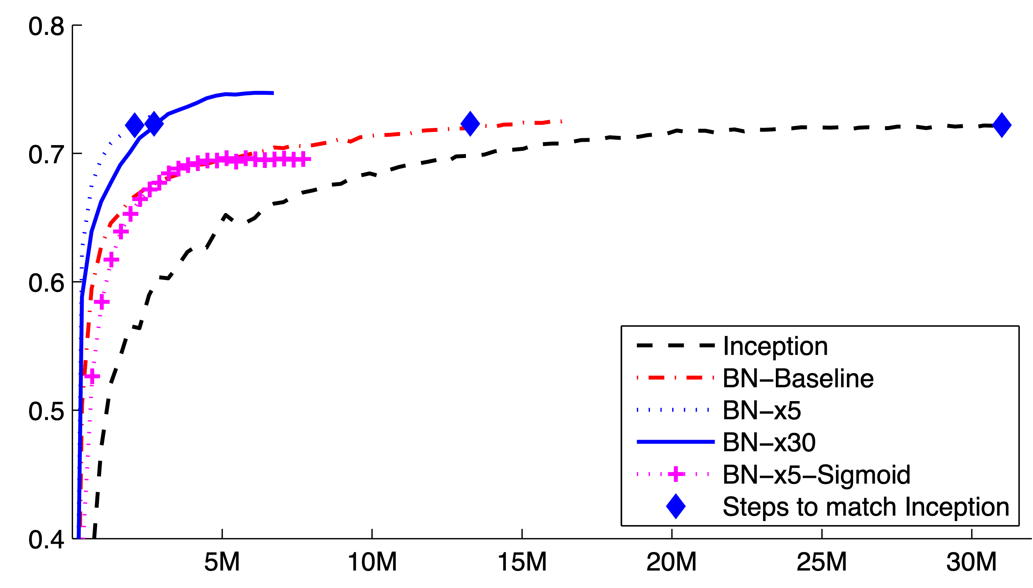
“Batch Normalization: Accelerating Deep
Network Training by Reducing Internal
Covariate Shift,” Ioffe and Szegedy 2015

Slide 12
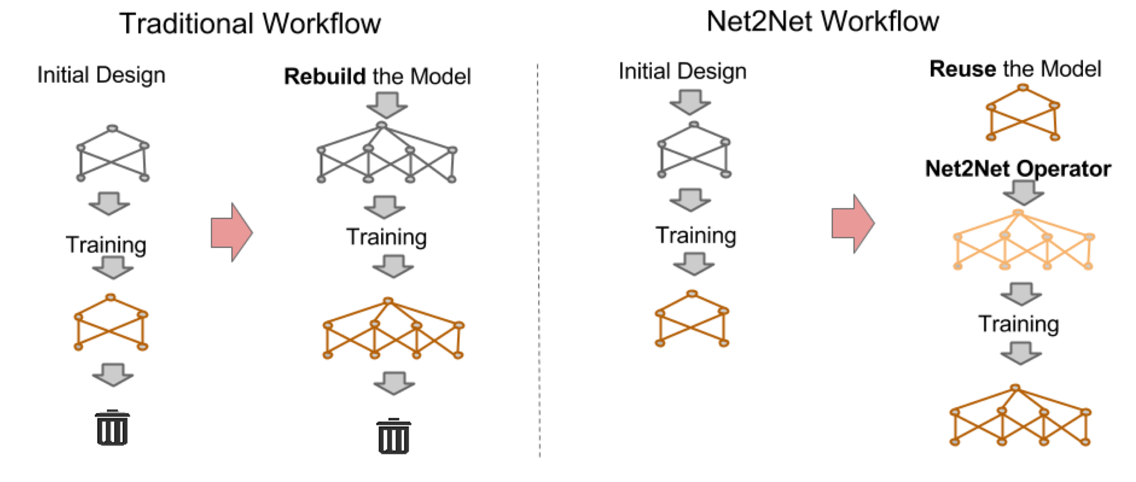
“Net2Net: Accelerating Learning via
Knowledge Transfer.” Chen, Goodfellow,
and Shlens, submitted to ICLR 2016

Slide 13
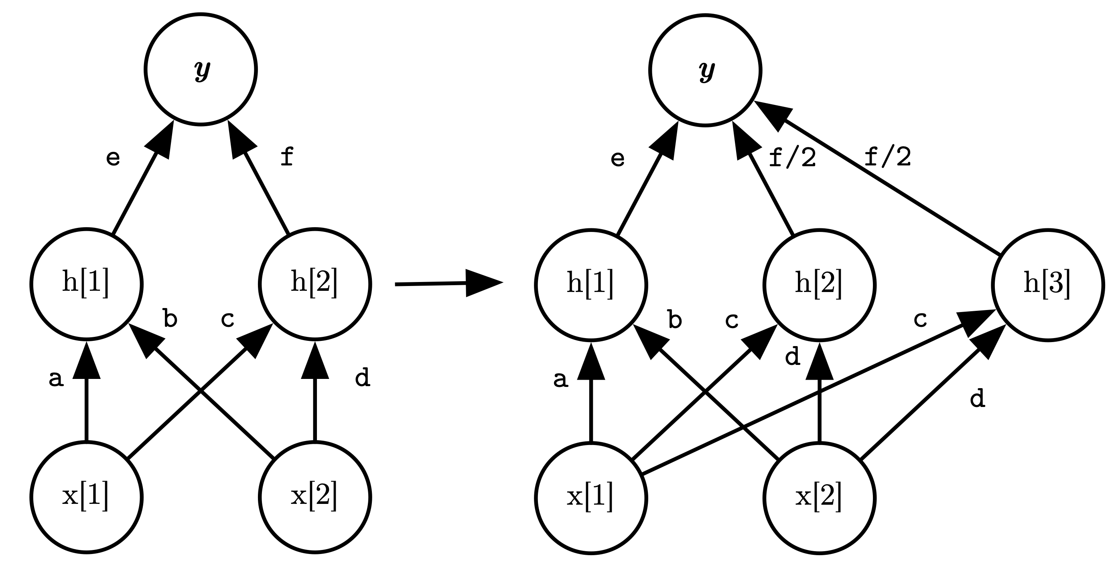
“Net2Net: Accelerating Learning via
Knowledge Transfer.” Chen, Goodfellow,
and Shlens, submitted to ICLR 2016

Slide 14
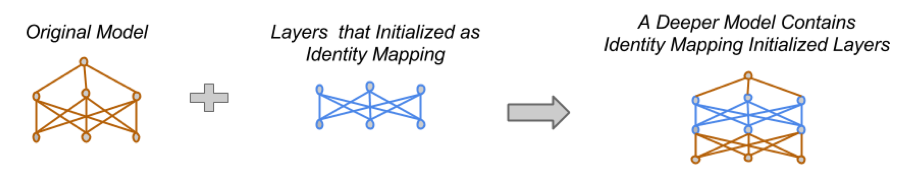
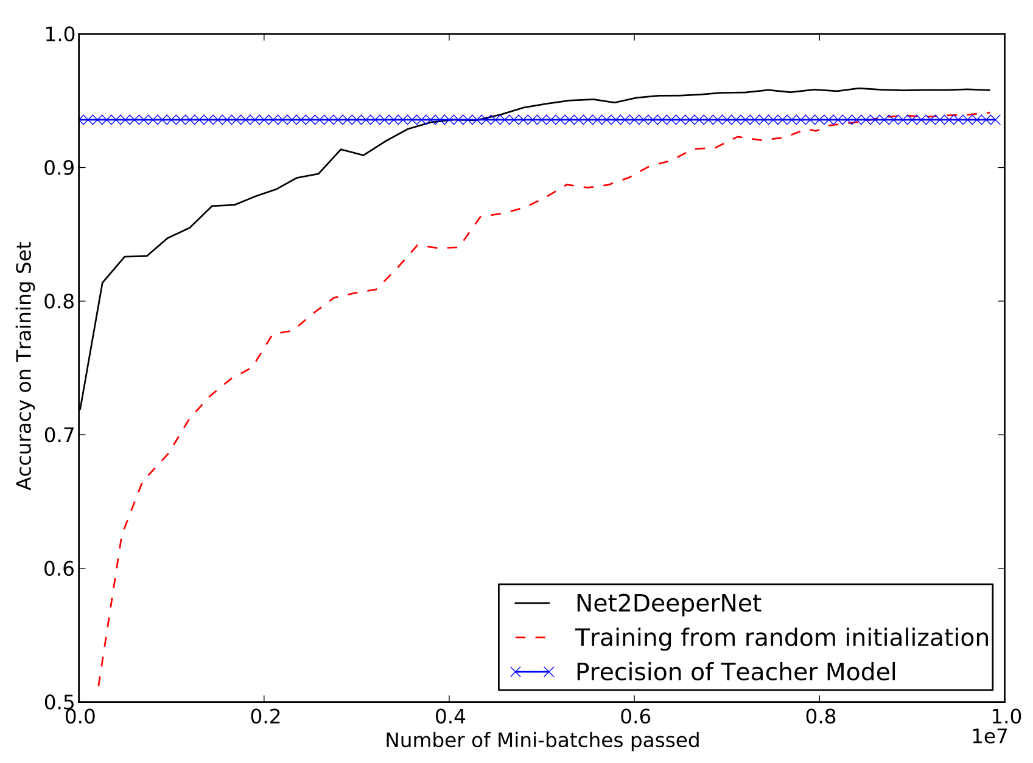
“Net2Net: Accelerating Learning via
Knowledge Transfer.” Chen, Goodfellow,
and Shlens, submitted to ICLR 2016

Slide 15
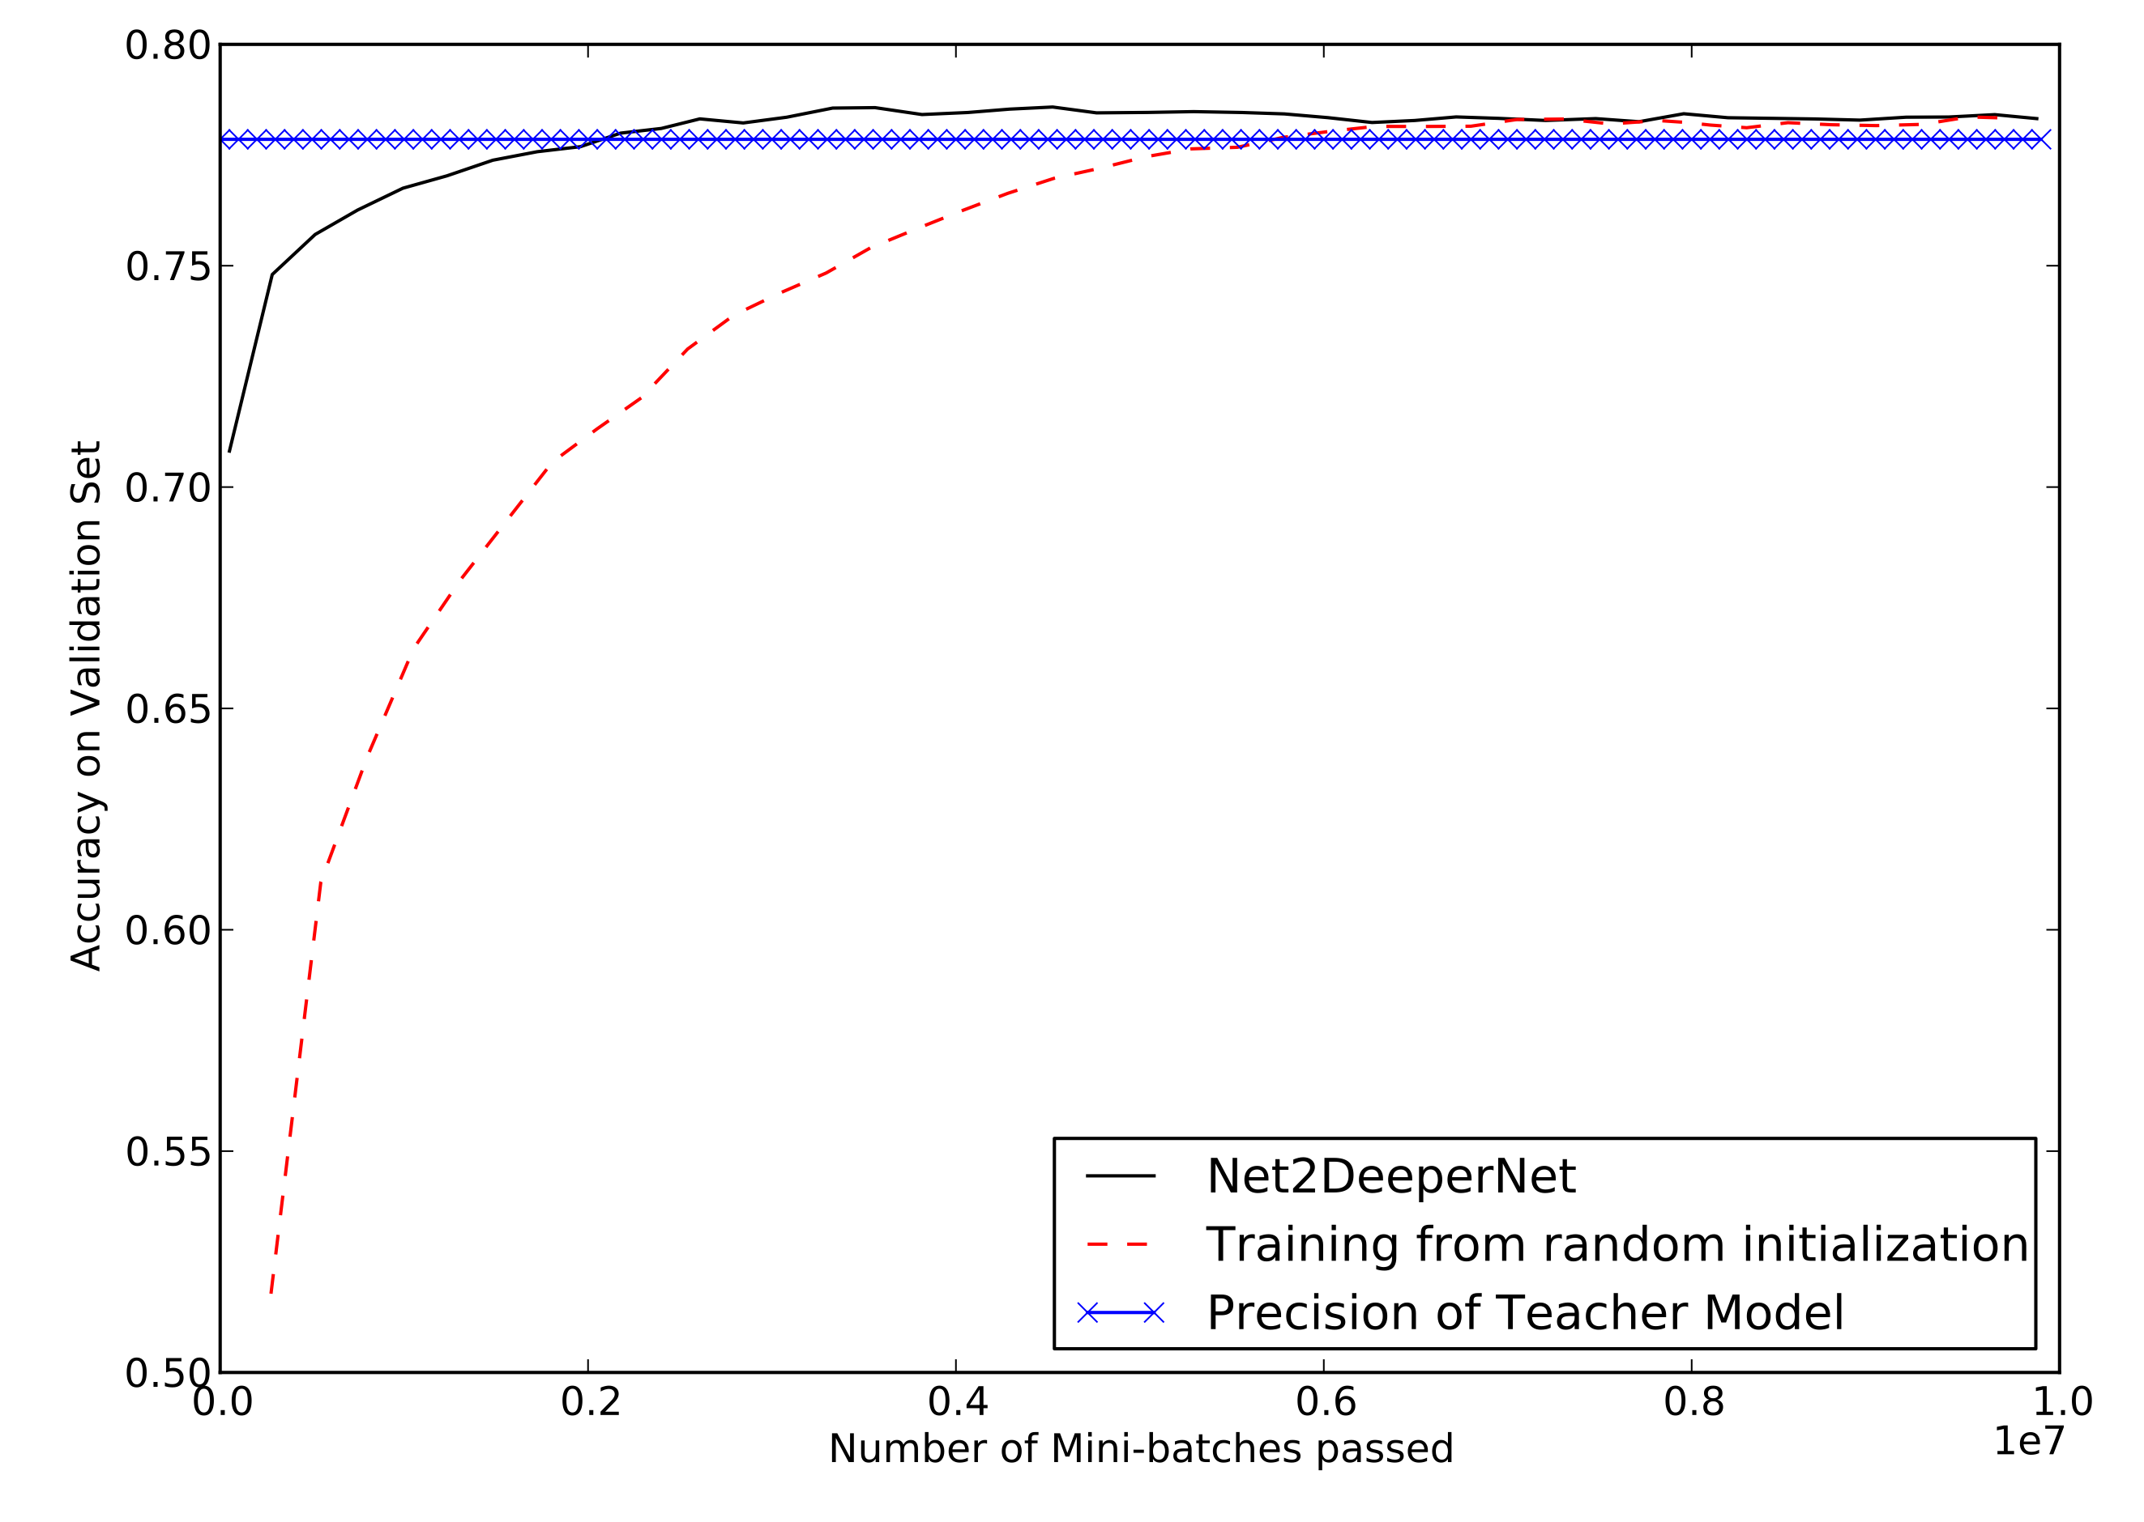
“Net2Net: Accelerating Learning via
Knowledge Transfer.” Chen, Goodfellow,
and Shlens, submitted to ICLR 2016

Slide 16
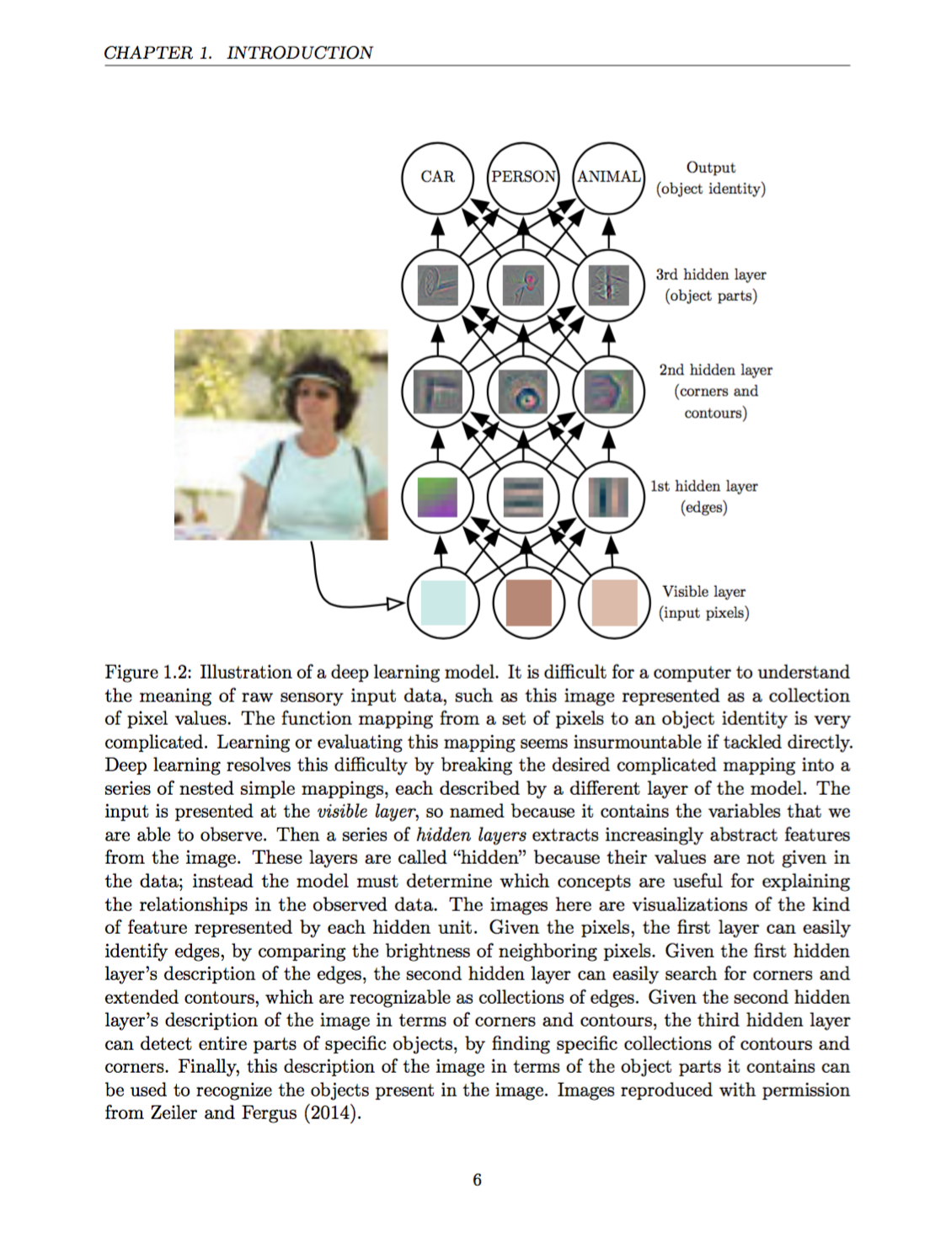
Deep Learning
Goodfellow, Bengio,
and Courville
www.deeplearningbook.org
In preparation for MIT Press

